Slide 1
OPENING
“Quick question — what’s the fastest way to lose a client during consultation?”

Slide 2

Section 1
Consultation
Flow
Greeting & rapport
Discovery questions
Assessment
Education
Recommendation
Managing expectations
Closing & documentation

Slide 3

SECTION 2 — ASKING THE RIGHT QUESTIONS
VIRTUAL INTERACTIVE METHOD
:
“Open-ended or Closed-ended?”
Which is better?
1 Do you use skincare
2 Tell me about your routine

Slide 4
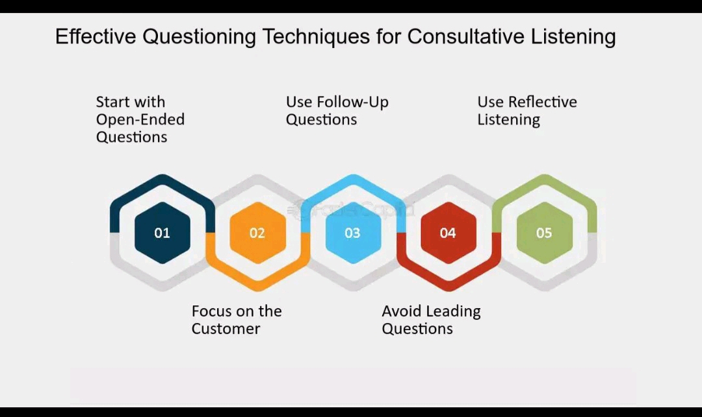

Slide 5
MEMORIZE THIS RULE:
“The quality of your consultation depends on the quality of your questions.”
IMPORTANT QUESTIONS TO ASK
Medical & Safety
Allergies?
Pregnancy?
Isotretinoin use?
Previous procedures?
Sensitivities?
Emotional/Motivational
“What concerns you most?”
“How long has this bothered you?”
“What result are you hoping for?”

Slide 6

SECTION 3 — MANAGING EXPECTATIONS
POLL QUESTION
“Which statement is safer professionally?”
A.
“This treatment will clear your acne.”
B.
“Most clients see gradual improvement with consistency

Slide 7
Note
Never over promise
Do not underestimate potential risks and side effects
Educate clearly!!
Over deliver when possible

Slide 8
LIVE SCENARIO EXERCISE
Scenario:
Client says:
“I want flawless skin in 2 weeks.”

Slide 9
SECTION 4 — PROFESSIONAL COMMUNICATION
NOTE THESE AREAS
Tone
Calm
Respectful
Confident
Body Language (Even Virtually)
Avoid multitasking
Don’t appear distracted
Maintain professional facial expressions

Slide 10

SECTION 5 — HANDLING NERVOUS CLIENTS
LIVE SIMULATION
You act as nervous client:
“What if my face reacts?” “Will it hurt?” “What if I break out worse?”, Are chemical peels safe?

Slide 11
SECTION 6 — DOCUMENTATION
Consent
History
Products
Reactions
Photos
Recommendations
Aftercare

Slide 12
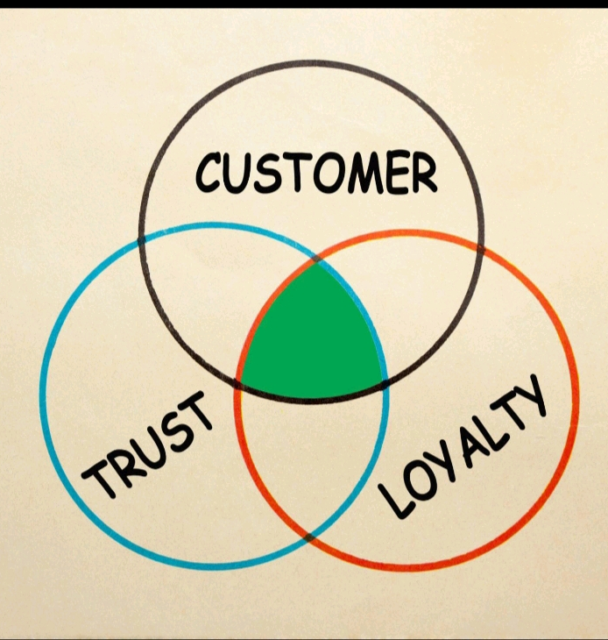
SECTION 7 — REASSURANCE & BUILDING TRUST
DISCUSSION QUESTION
Ask:
“Why do clients return to some practitioners even when prices are higher?”

Slide 13
Trust
Communication
Comfort
Professionalism
Results
Emotional connection
Trust is built through:
Honesty
Consistency
Listening
Professional boundaries
Follow-up

Slide 14


